Slide 1
Management skills

Slide 2
Management Functions
Objectives
Name the three functions of management
Describe the management techniques used by effective managers
Explain how to manage employees properly
Marketing Essentials Chapter 11, Section 11.2

Slide 3




Best Companies to Work For
Watch the video on the Best companies to work for (next slide).
As you view, list some of the top reasons you see/hear on why these are voted best place to work in your note packet

Slide 4

Best Places to Work

Slide 5
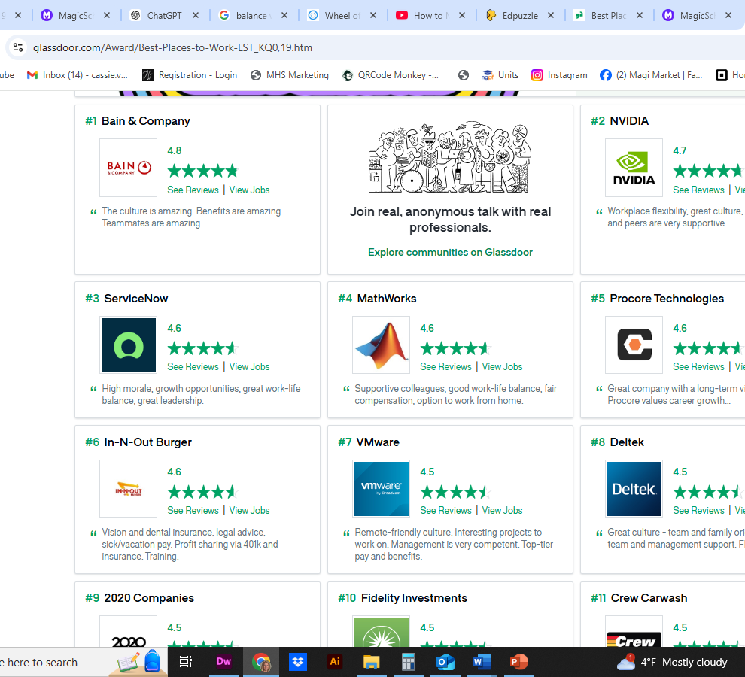
Top 10 in 2024
Which are still on the top 10?

Slide 6

Why the Best
Employees rewarded for work
Strong Emphasis on teamwork
Social Activities
Mission Driven
Competitive Pay & Benefits
Career Advancement Opportunities
Great Employees
In 2024: Competitive compensation and benefits, Strong work-life balance, robust career development opportunities, positive company culture, commitment to diversity and inclusion, employee satisfaction, job security, innovative work environment, leadership quality, and a strong reputation

Slide 7

Quick Write: Answer the following in your activity Packet
From the list Above answer the following scenario: You decide to start a new business. What key factors are you going to attempt to include for employees that work for you?
As per the video: Why is having happy employees so important?

Slide 8
Assignment
Read the Article Work
Answer the questions on Page 2 in your packet from the Article
There will be a quiz on this tomorrow.

